Slide 1
M.A.R.C.H.
Direct Pressure

Slide 2
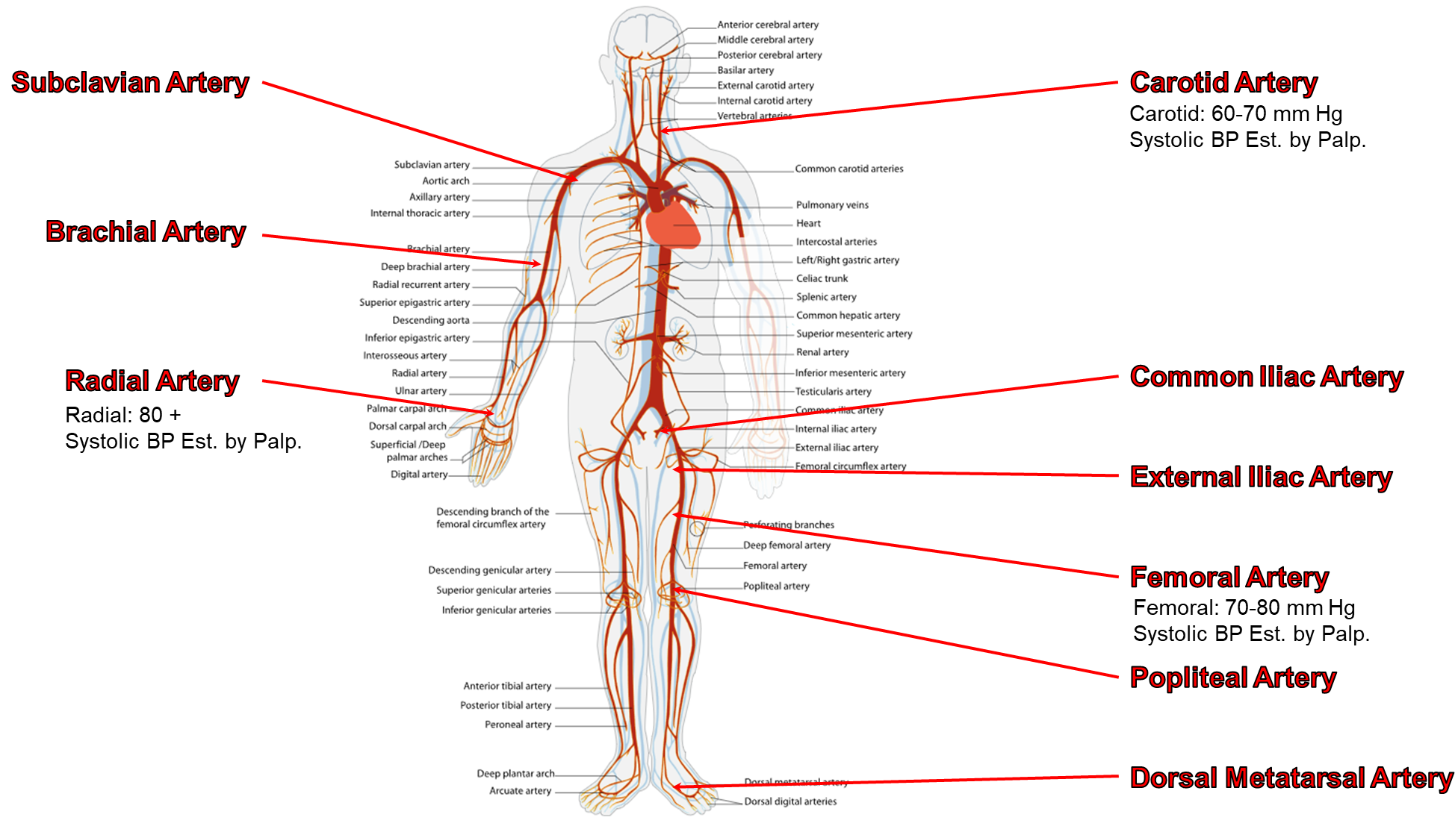
Pressure points

Slide 3
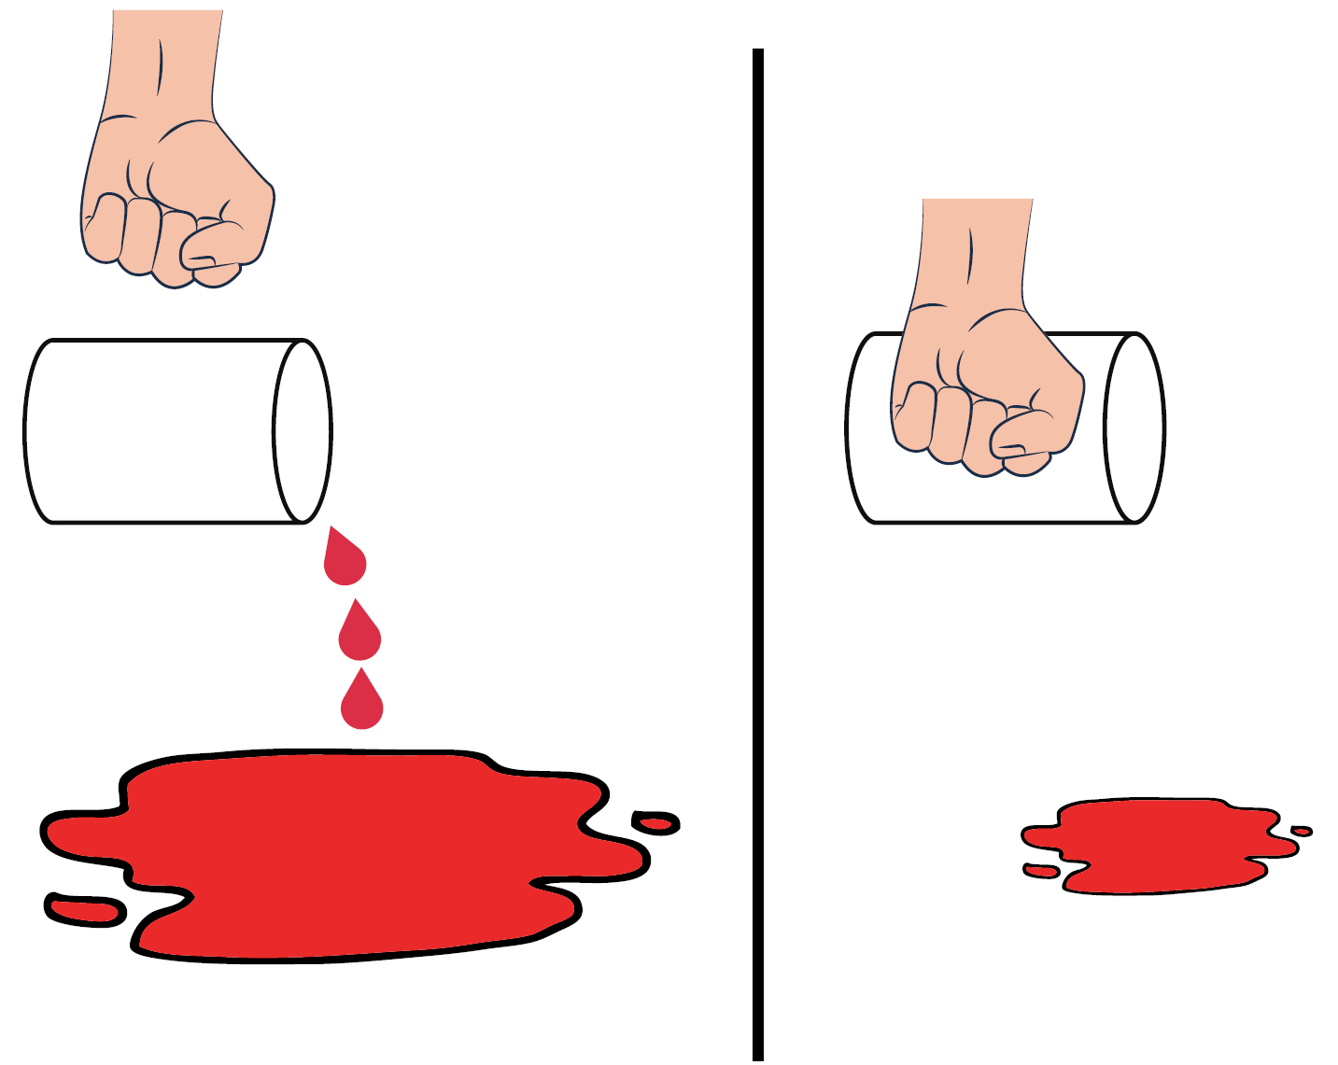
Principles
M
A
R
C
H
Flatten artery to backstop (bone)
Diffuse pressure to pinpoint pressure
Stop-gap till more definitive hemorrhage control is achieved
Confirm efficacy of direct pressure by visualizing the absence or reduction of bleeding
Notes:
1. Tactical Emergency Casualty Care (TECC) Guidelines for First Care Providers. http://c-tecc.org/guidelines/civilian-first-care-provider

Slide 4
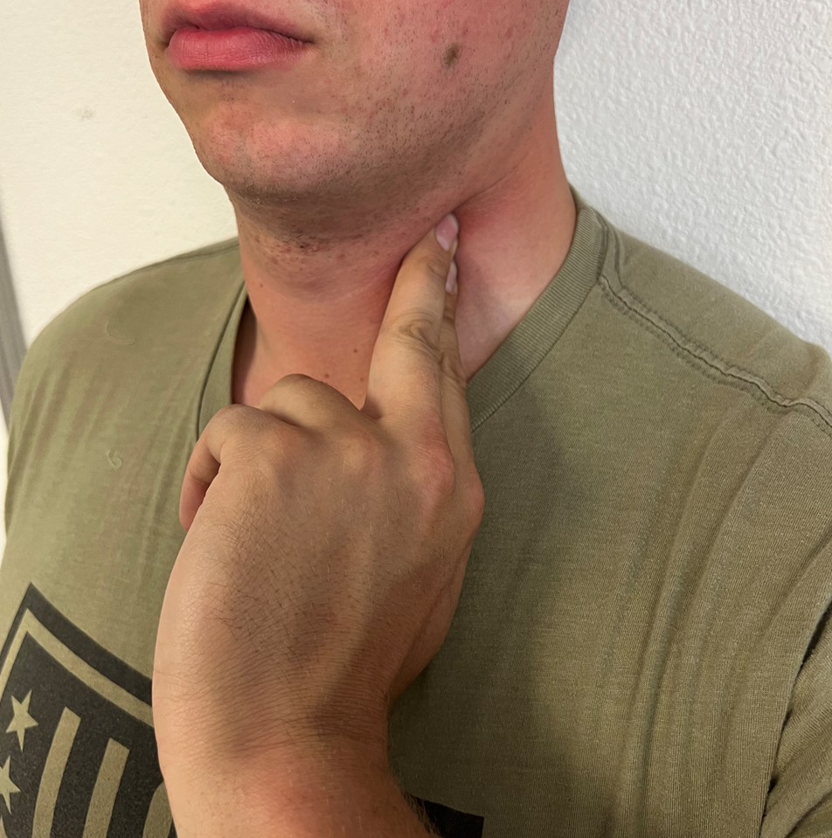
Carotid Artery - Neck
M
A
R
C
H
Tactics:
Fastest to bleed out, easiest to control
Can be performed with self-aid or buddy aid
Finger placement is on the carotid artery between the wound and the heart
Finger positioning is similar to taking a carotid pulse
Two fingers placed in the proper location can render adequate pressure
Notes:
1. Tactical Emergency Casualty Care (TECC) Guidelines for First Care Providers. http://c-tecc.org/guidelines/civilian-first-care-provider

Slide 5
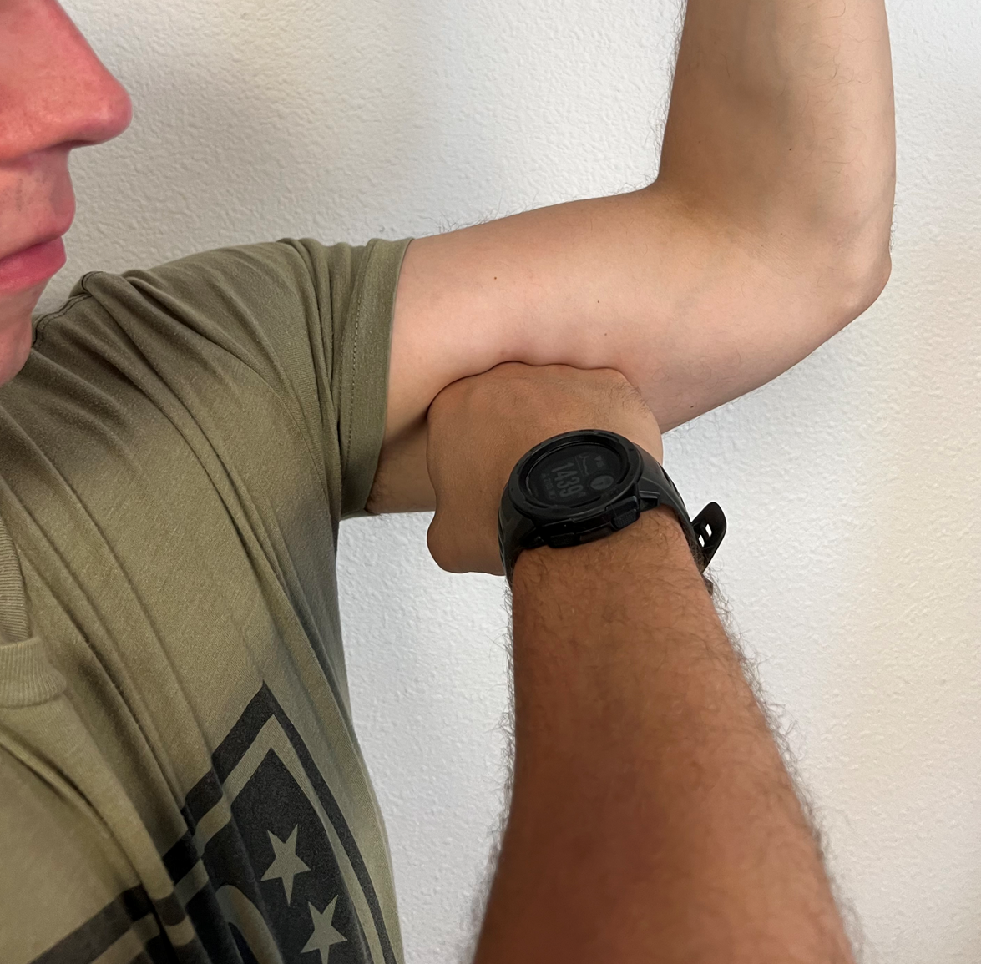
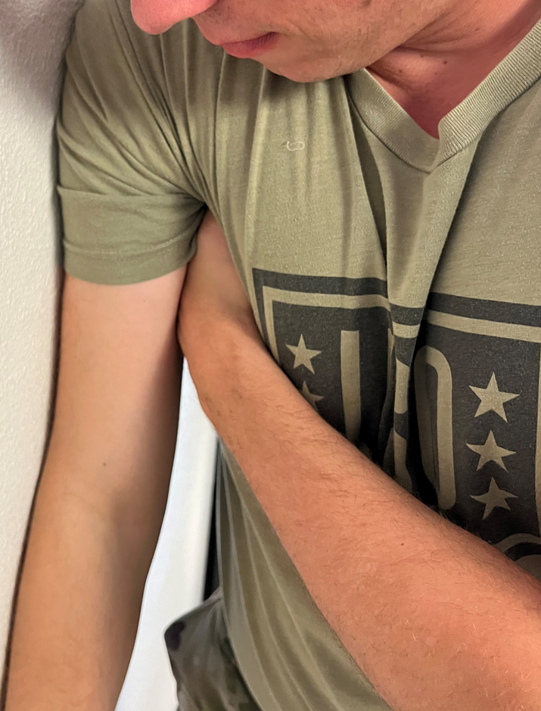
Brachial Artery – Arm (Self-aid)
M
A
R
C
H
Tactics:
Make a fist and put it between the bicep and triceps muscles on the inside of the upper arm
Additional force can be applied with this method by leaning into a wall or laying on the arm while on the ground
Notes:
1. Tactical Emergency Casualty Care (TECC) Guidelines for First Care Providers. http://c-tecc.org/guidelines/civilian-first-care-provider

Slide 6
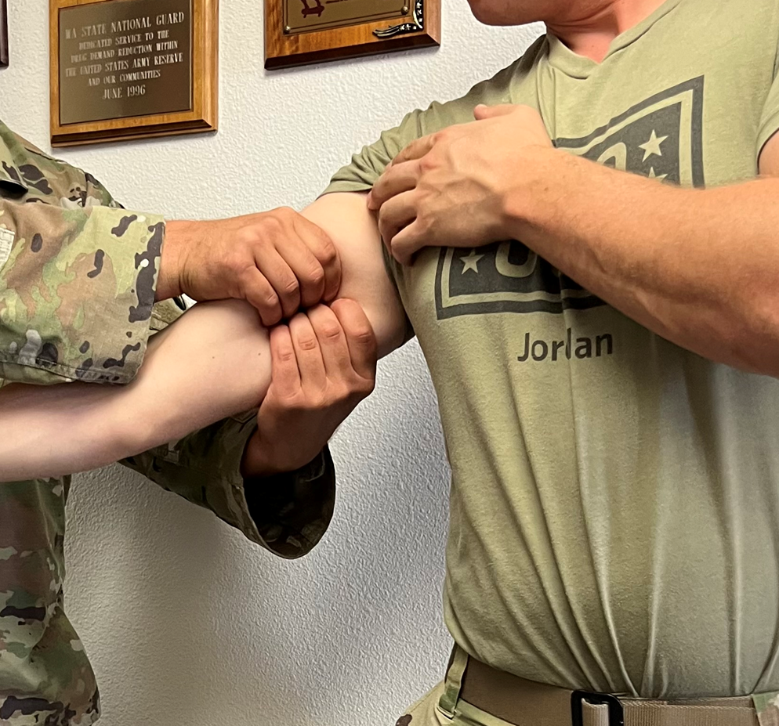
Brachial Artery – Arm (Buddy-aid)
M
A
R
C
H
Tactics:
Can be performed with self-aid or buddy aid
Finger placement is on the inside of upper arm at the gap between the bicep and triceps muscles
Finger positioning is a circumferential grip around the upper arm. Use thumbs/palms as a backstop and dig all eight additional fingers into the pulse point
Very similar to the escort position, if done with one hand
Notes:
1. Tactical Emergency Casualty Care (TECC) Guidelines for First Care Providers. http://c-tecc.org/guidelines/civilian-first-care-provider

Slide 7
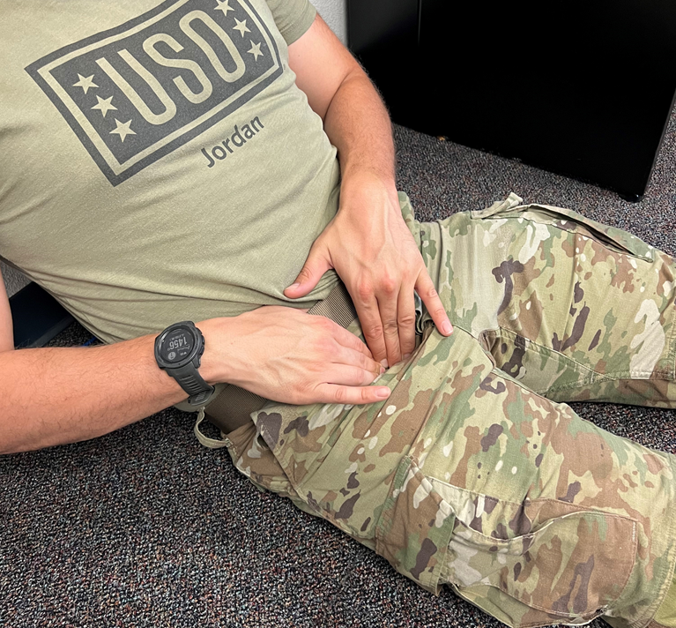
Femoral Artery – Leg (Self-aid)
M
A
R
C
H
Tactics:
Place all eight fingers in a straight line on the inguinal crease and push
One of the fingers will be pushing against a bony prominence/nerve bundle. That is where the artery is.
Adjust your fingers to pinpoint the artery with direct pressure rather than dispersed pressure
Hold that point until additional help and/or resources are available to assist you
Notes:
1. Tactical Emergency Casualty Care (TECC) Guidelines for First Care Providers. http://c-tecc.org/guidelines/civilian-first-care-provider

Slide 8
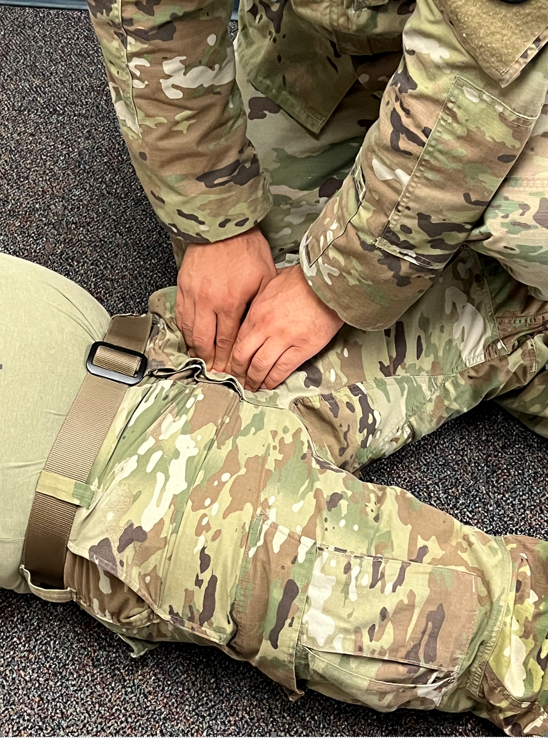
Femoral Artery – Leg (Buddy-aid)
M
A
R
C
H
Tactics:
Femoral artery self-aid and buddy-aid have identical steps when applying direct pressure
This is easiest to perform if you position the casualty’s knee so it’s slightly turned outward
Notes:
1. Tactical Emergency Casualty Care (TECC) Guidelines for First Care Providers. http://c-tecc.org/guidelines/civilian-first-care-provider

Slide 9
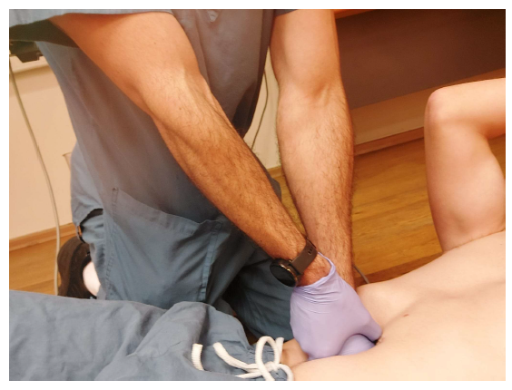
Aorta Artery - Belly Button / Lower Half
M
A
R
C
H
Tactics:
Make a fist and push immediately above the belly button
The intent is to flatten the aorta to the inside of their spine
  This will take significantly more force than any of the other direct pressure methods
Using a fist is preferred, but the knee is an effective method as well
Notes:
1. Tactical Emergency Casualty Care (TECC) Guidelines for First Care Providers. http://c-tecc.org/guidelines/civilian-first-care-provider

Slide 10
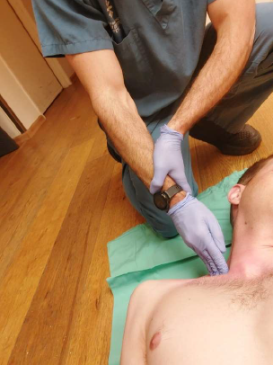
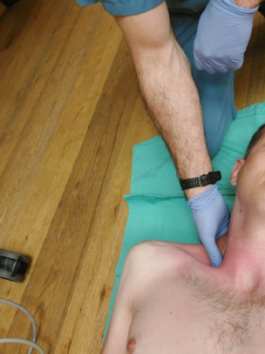
Subclavian Artery – Clavicle / Arm
M
A
R
C
H
Tactics:
This is the most challenging method to perform
The landmark is in the “V” where the clavicle (collar bone) meets the muscle of the neck
Push behind the clavicle to flatten the subclavian artery against the 1st rib
Pressure needs to be applied diagonally (pushing toward the midline/heart) rather than applied straight down (toward the lung)
This method is best performed when the treater is located above the casualty’s head (like in the photo) and can be performed with the index/middle finger or the thumb
Notes:
1. Tactical Emergency Casualty Care (TECC) Guidelines for First Care Providers. http://c-tecc.org/guidelines/civilian-first-care-provider

